Slide 1


Slide 2

Major Project-II (01CE0807), Semester 8
Final review (31/01/2026)
LearnDesk : A Secure and Dynamic Online learning Platform
Team ID: 8PRO_085
Team Member 1: Ajay Joshi (92201703192) (EC2)
Team Member 2: Het Dalsaniya (92201703202) (EC2)
Team Member 3: Twisha Gol (92200103018)(TC2)
Guided By
Internal Guide Name: Prof. Paras Shingadiya
Department of Computer Engineering, Faculty of Engineering & Technology

Slide 3
Outline
Abstract
Problem Statement
Literature Review
Objective
Features
Technology Stack
Methodology
System Architecture
Flowchart
Results / Output
Expected Outcome
Patent / GitHub Updates

Slide 4
Abstract
LearnDesk is a smart learning platform built using the MERN stack that connects teachers and students through interactive learning. Teachers can create classes, manage students, and design custom quizzes, while students can join classes or freely practice aptitude tests covering verbal, logical, and quantitative skills. All quizzes are time-based with instant results and strict security against tab switching or copying. The platform ensures safe access through email verification, JWT-based login, and data encryption—offering a secure, complete, and engaging environment for learning and assessment.

Slide 5
Problem Statement
Current Situation:
In most colleges, placement preparation is scattered , students use random websites for learning, practice quizzes, and tracking performance, while teachers or counselors struggle to monitor progress.
Problems student faced :
No centralized system for placement-oriented MCQ assessments.
Students lack structured learning resources and topic-wise practice.
Teachers can’t create or manage secure quizzes for specific classes easily.
Random preparation without progress tracking reduces placement readiness.
Need:
A unified platform that helps students learn, practice, and track progress, while enabling teachers to create and manage class-based quizzes for placement drives.

Slide 6
Literature Review
1. GeeksforGeeks (GFG): GeeksforGeeks provides a large collection of articles, tutorials, and coding questions for placement preparation. However, it lacks a built-in quiz management system and does not offer real-time or class-based assessment features, making it less interactive for structured learning.
URL - https://www.geeksforgeeks.org/aptitude/aptitude-questions-and-answers/
2. IndiaBix: IndiaBix offers multiple-choice questions across aptitude and reasoning topics, but it lacks secure user authentication, real-time evaluation, and progress tracking. It is more suited for offline practice than organized class-based learning.
URL - https://www.indiabix.com/

Slide 7
Literature Review
3. Canvas LMS: Canvas is a powerful learning management system widely used in education, but it primarily focuses on course delivery and classroom interaction. It does not provide built-in placement-oriented quizzes or custom secure MCQ assessments required for placement drives.
URL - https://sa.instructure.com/login/canvas
4. Sanfoundry
Sanfoundry provides a vast repository of MCQ questions across engineering, aptitude, and competitive exam domains. While it supports topic-wise practice tests, it does not offer personalized dashboards, class-specific assessments, or performance analytics.
URL: https://www.sanfoundry.com

Slide 8
Literature Review
5. CareerRide
CareerRide focuses on aptitude, technical, and interview preparation by offering multiple-choice questions and explanations. However, it lacks features such as user login, exam scheduling, real-time result generation, and teacher-controlled assessments. This limits its usability in academic environments where progress tracking and evaluation are essential. URL: https://www.careerride.com/
6. Testbook
Testbook offers structured test series, mock exams, and performance analysis for competitive exams. While it includes progress tracking, its primary focus is on large-scale competitive exams rather than classroom-based assessments. URL: https://testbook.com/
.

Slide 9
Literature Review
7. Unacademy (Practice Platform)
Unacademy provides live classes, quizzes, and test series for various exams. However, its platform is heavily content-centric and subscription-based, making it less flexible for small institutions or custom classroom-level quiz management and evaluation systems.
URL: https://unacademy.com/
8. LearnDesk (Proposed System): LearnDesk bridges these gaps by combining learning materials, topic-wise and random quizzes, secure login, and class-based features under one unified platform — specifically tailored for placement preparation and assessment.

Slide 10
Objective
Our main goal is to build a centralized online learning platform that simplifies placement preparation through topic-based learning, MCQ practice, and class-based assessments.
What we provide :
Provide articles and study materials to help students learn key placement topics.
Offer built-in quizzes for topic-wise practice and instant feedback.
Enable random quiz generation for comprehensive revision.
Allow teachers/counselors to create classes, add students, and generate custom quizzes.
Help students track progress and readiness for upcoming placement drives.
Outcome:
A one-stop web application that bridges the gap between learning and assessment for placement training programs.

Slide 11
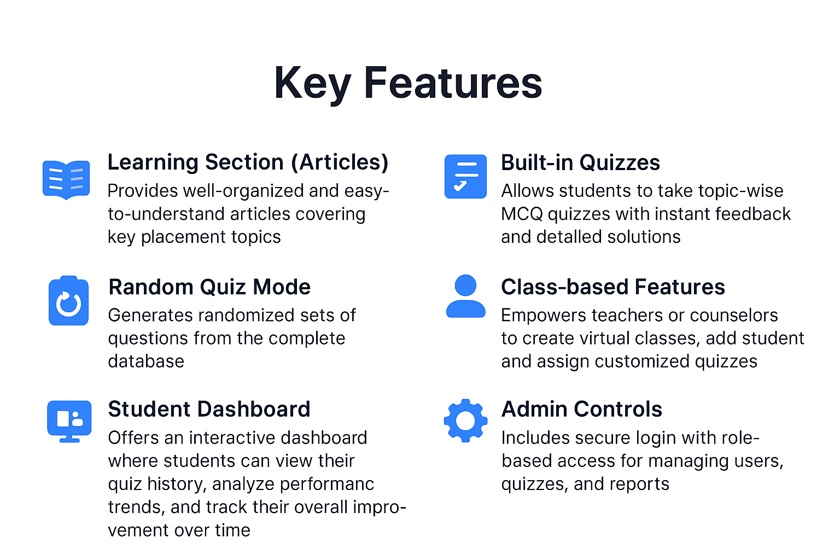
Features

Slide 12
Technology Stack
React.js, Axios, Bootstrap
Builds a dynamic and responsive interface for students and teachers; handles routing, quiz display, and API communication.
Frontend
Node.js, Express.js
Manages application logic, authentication, and REST APIs; processes requests and sends data to the frontend.
Backend
MongoDB
Stores user information, questions, quiz results, and class data in a flexible and scalable NoSQL structure.
Database
Render / Vercel / Netlify MongoDB Atlas
The app will be deployed online with backend and database hosted on secure cloud services for accessibility.
Hosting & Deployment

Slide 13
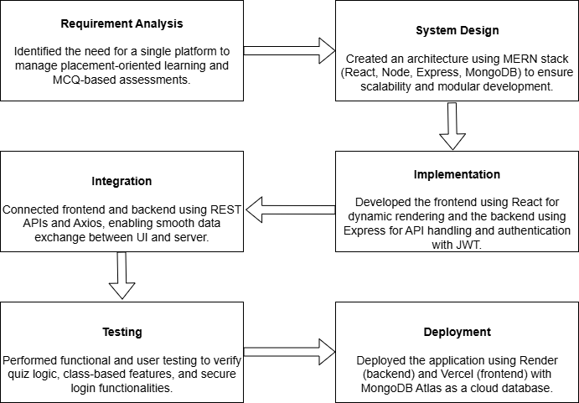
Methodology

Slide 14
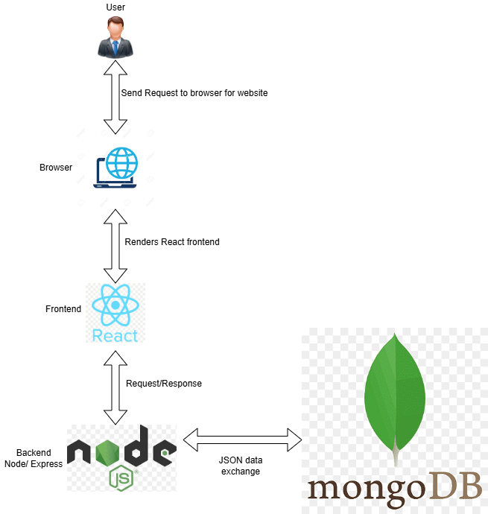
System Architecture
The LearnDesk architecture follows a client–server model based on the MERN Stack. Users interact through a React.js frontend, which communicates with the backend via RESTful APIs developed using Node.js and Express.js.
All data such as quizzes, users, and classes are securely stored in MongoDB Atlas. Authentication and authorization are handled using JWT tokens, ensuring data security, integrity, and controlled access across the platform.

Slide 15
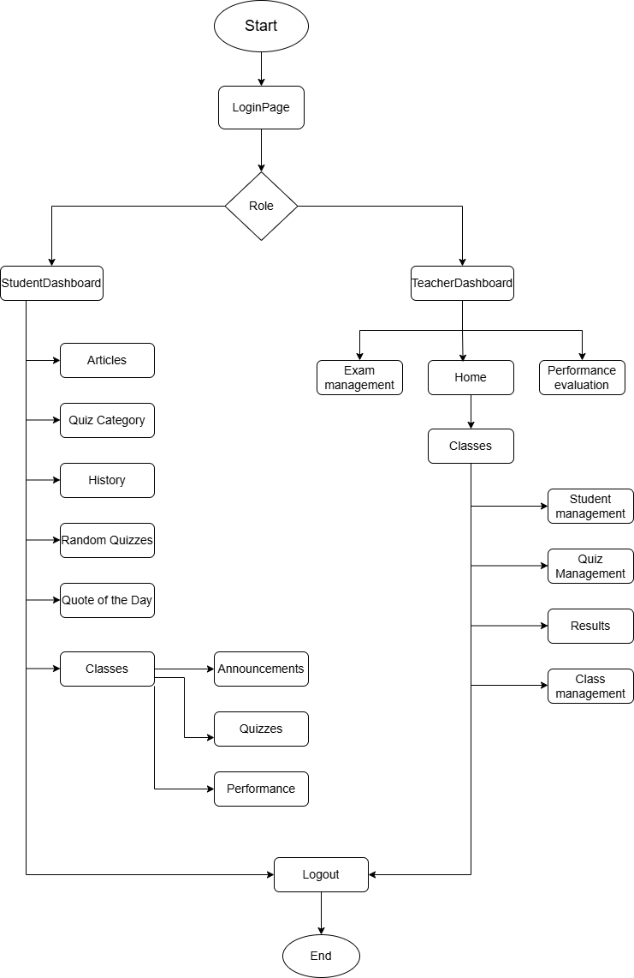
Flowchart

Slide 16
Flowchart

Slide 17
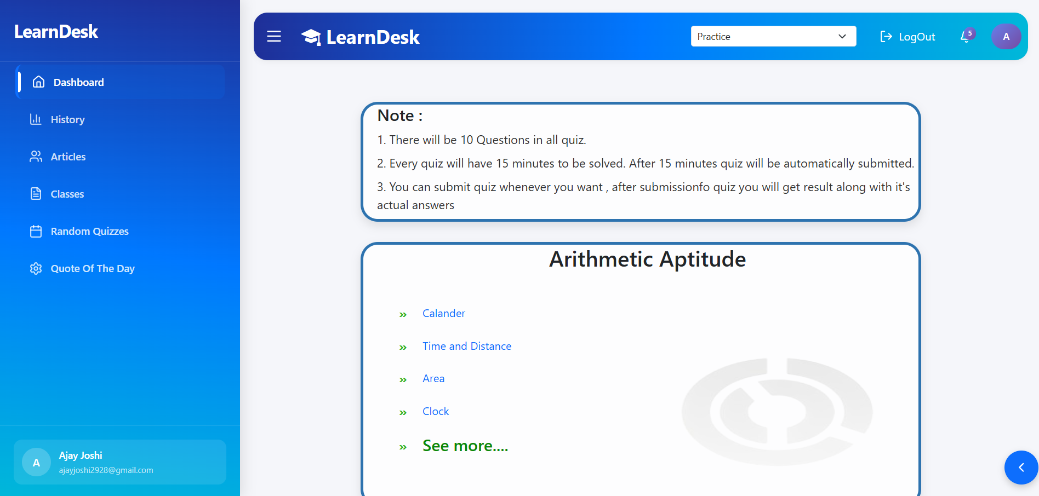
Results / Output

Slide 18
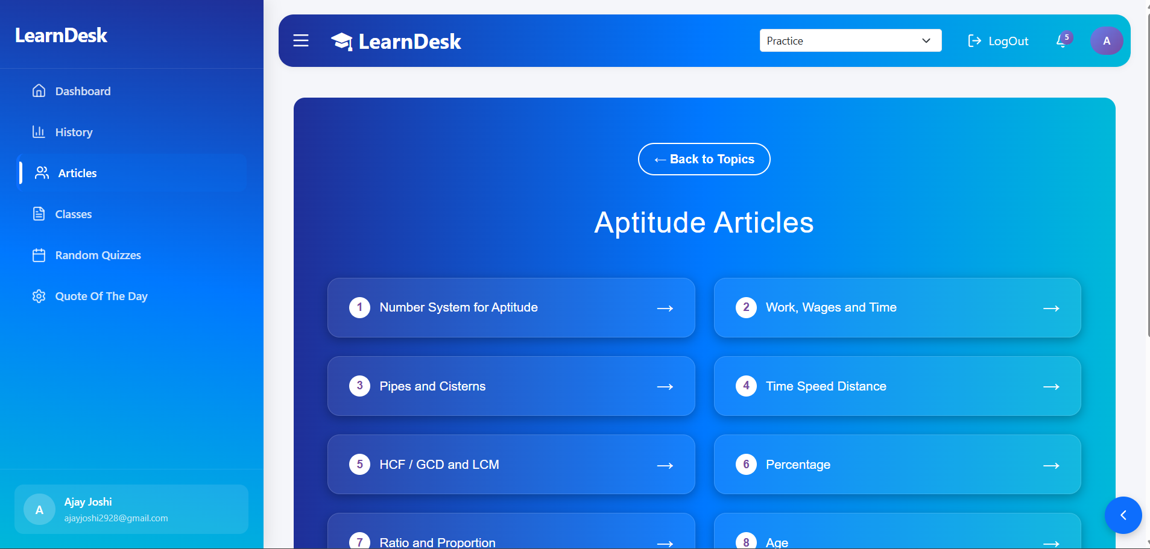
Results / Output

Slide 19
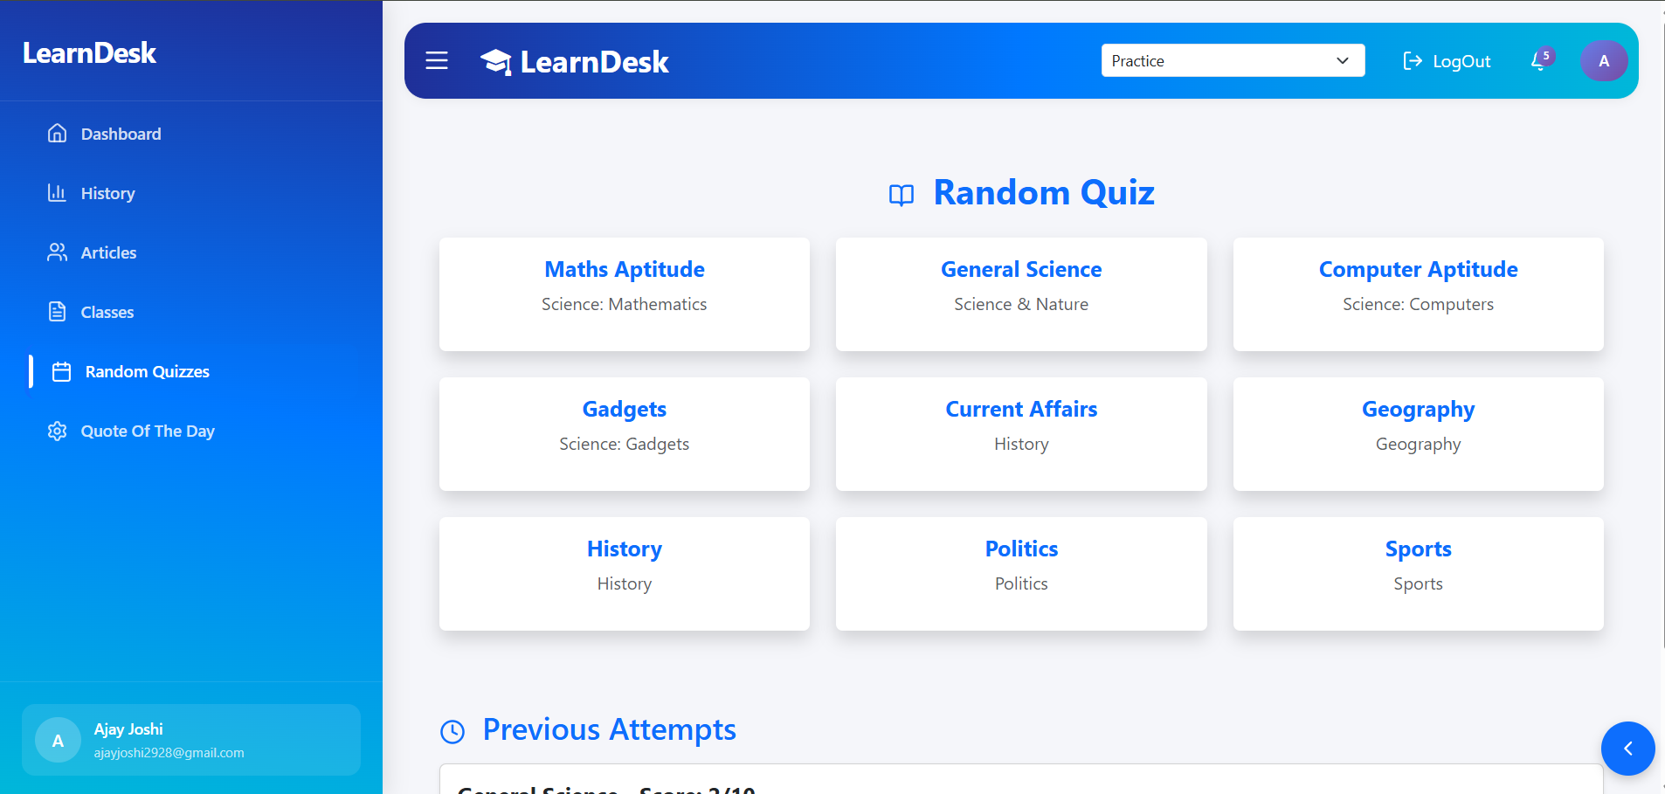
Results / Output

Slide 20
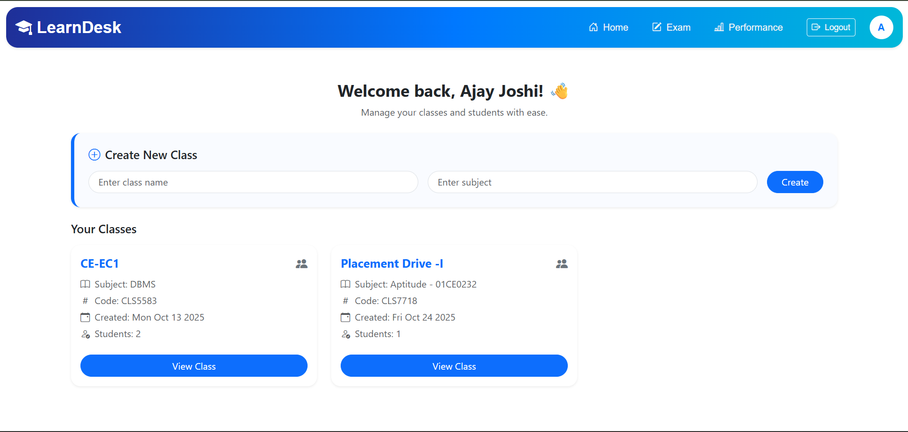
Results / Output

Slide 21
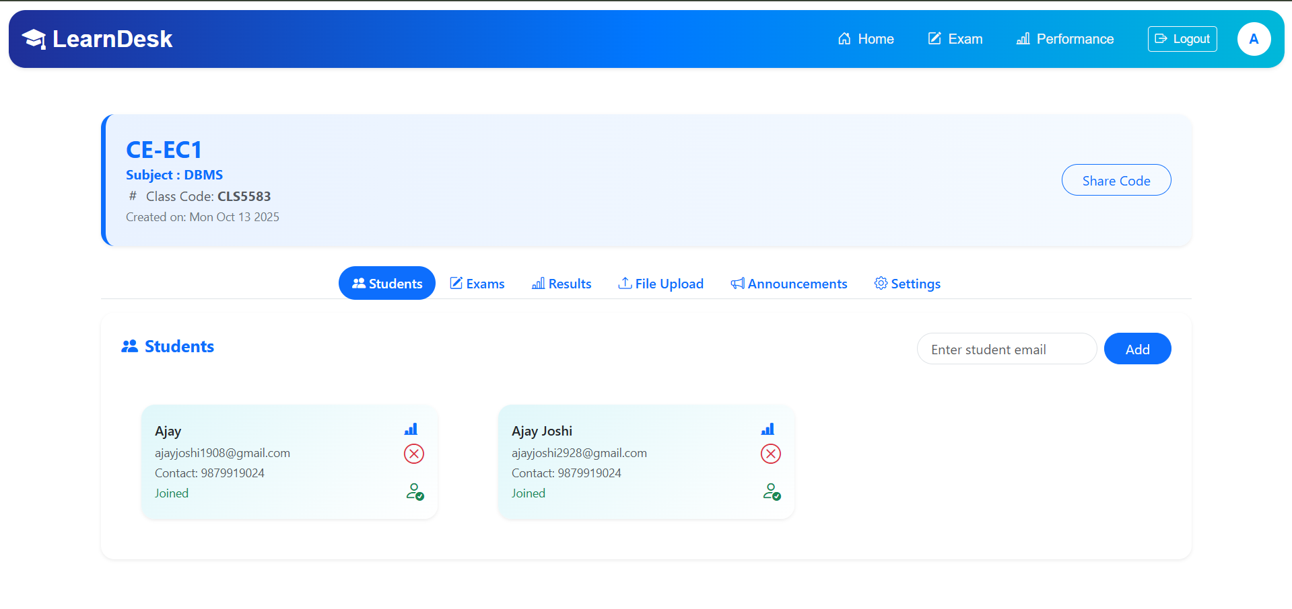
Results / Output

Slide 22
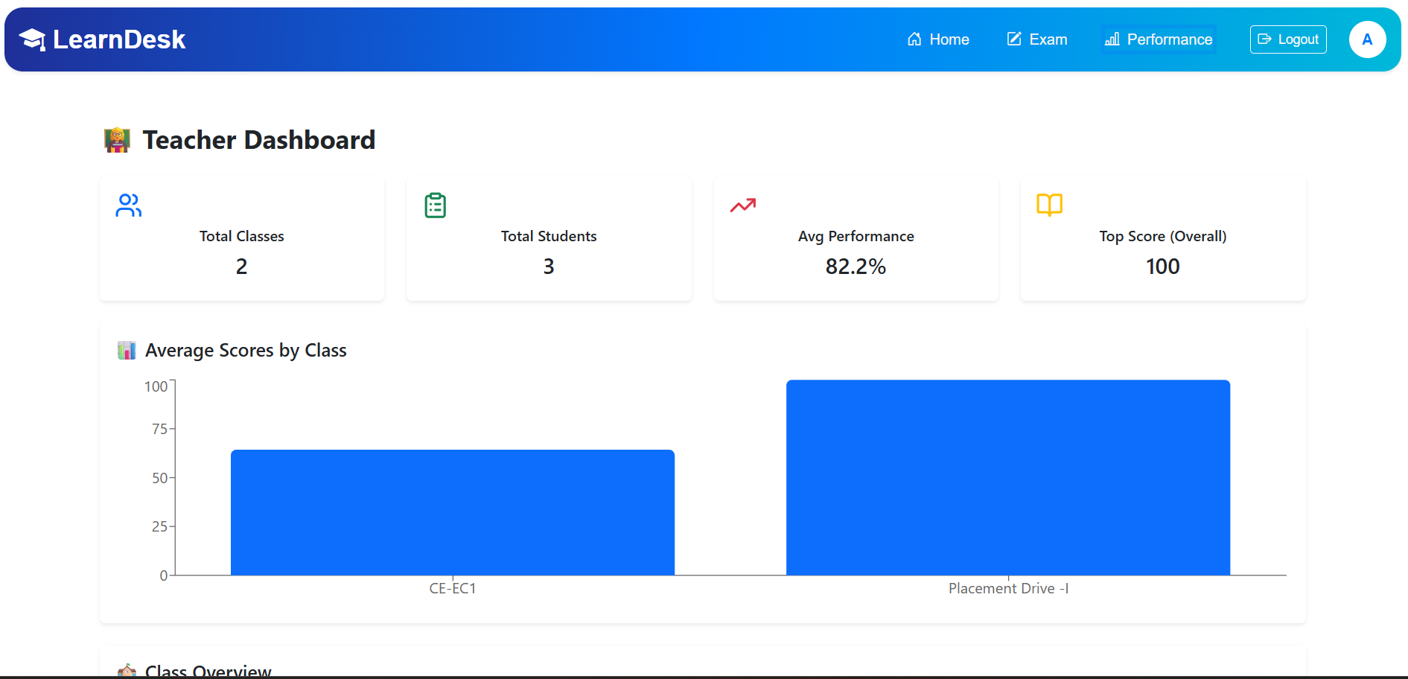
Results / Output

Slide 23
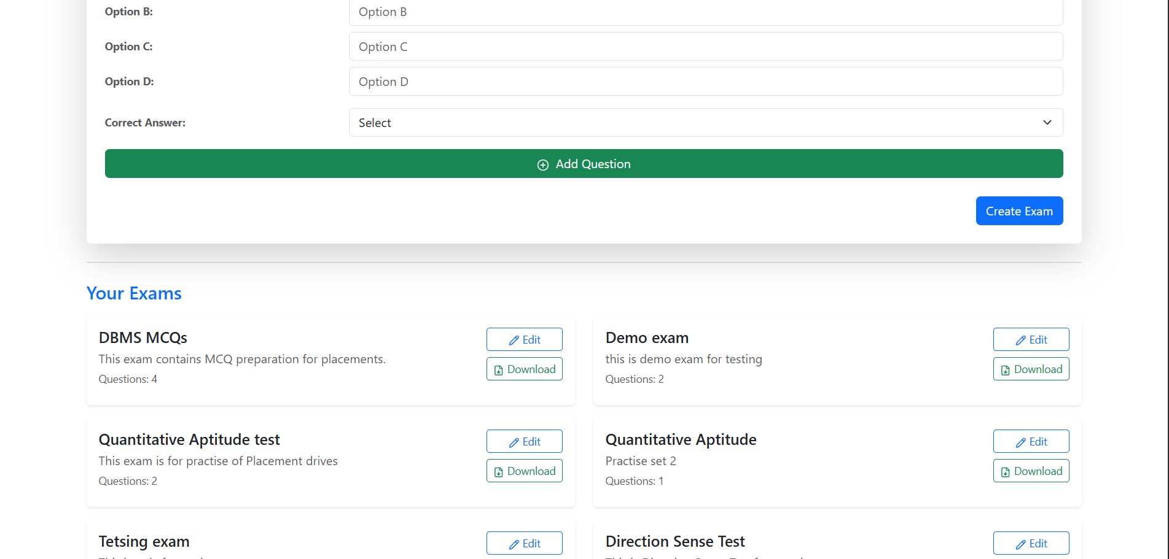
Results / Output

Slide 24
Expected Outcome
Functional Web Platform
A fully functional web-based learning and quiz platform for placement preparation.
Developed using the MERN Stack (MongoDB, Express.js, React.js, Node.js).
Secure User Management
Role-based access for students, teachers, and administrators.
Secure Quiz to increase fairness.

Slide 25
Expected Outcome
Interactive Quiz System
Custom, real-time, and topic-wise quizzes to enhance engagement.
Instant evaluation and detailed performance reports for users.
Analytics & Progress Tracking
Visual progress tracking dashboard for students.
Teachers can monitor and analyze class-level performance.

Slide 26
Patent / GitHub Updates
Github - https://github.com/AjayJoshi99/LearnDesk
Patent - https://docs.google.com/document/d/1n1VaE59RQPLBUWr1m7oAcxtOt32uZItL/edit?usp=drive_link&ouid=101468811541708741534&rtpof=true&sd=true
INVENTION DISCLOSURE FORM FOR PATENTS -
https://docs.google.com/document/d/1ENnbfmQ6KAJSN3RPPhiH1rxmUeLqJvR_/edit?usp=drive_link&ouid=101468811541708741534&rtpof=true&sd=true

Slide 27


Slide 28


